Slide 1
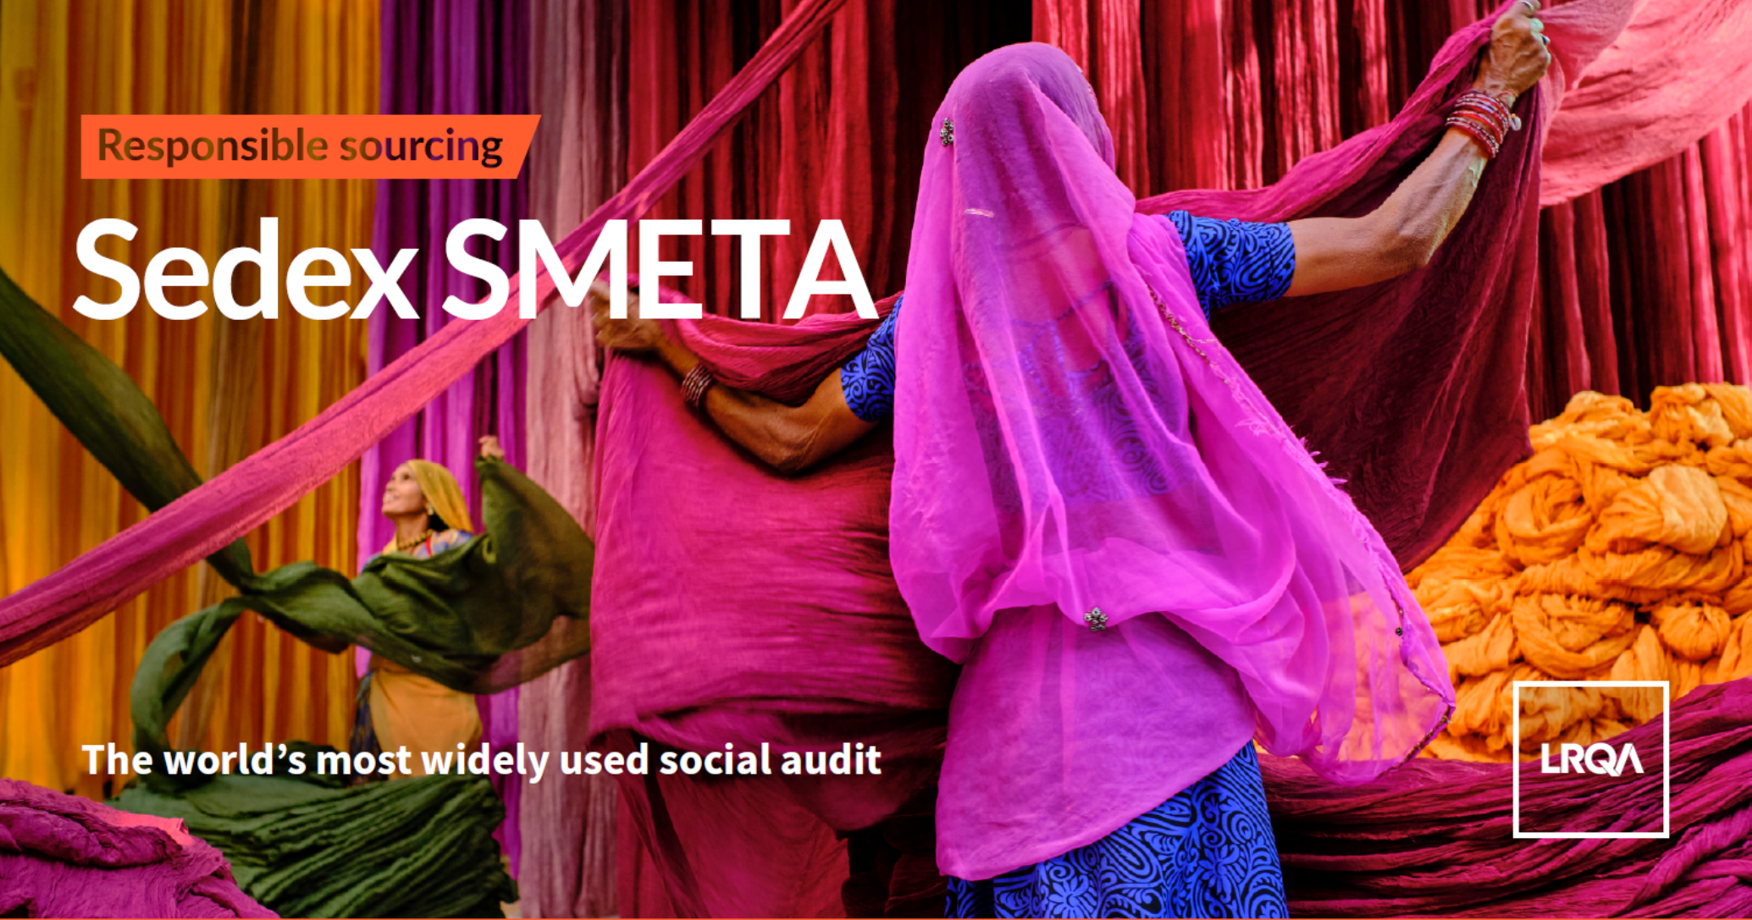

Slide 2
Contents
01 | Introducing LRQA
01 | LRQA’s Responsible Sourcing services
03 | SMETA Auditing with LRQA
04 | CAP Management and Supplier Improvement
05 | Servicing Customers: Client Portals
06 | Account Management
Optional: Worker Surveys
Optional: Program Design: Supplier Segmentation and Risk Assessment
LRQA Responsible Sourcing: SMETA

Slide 3
Introducing LRQA
Section 01
LRQA Responsible Sourcing: SMETA

Slide 4

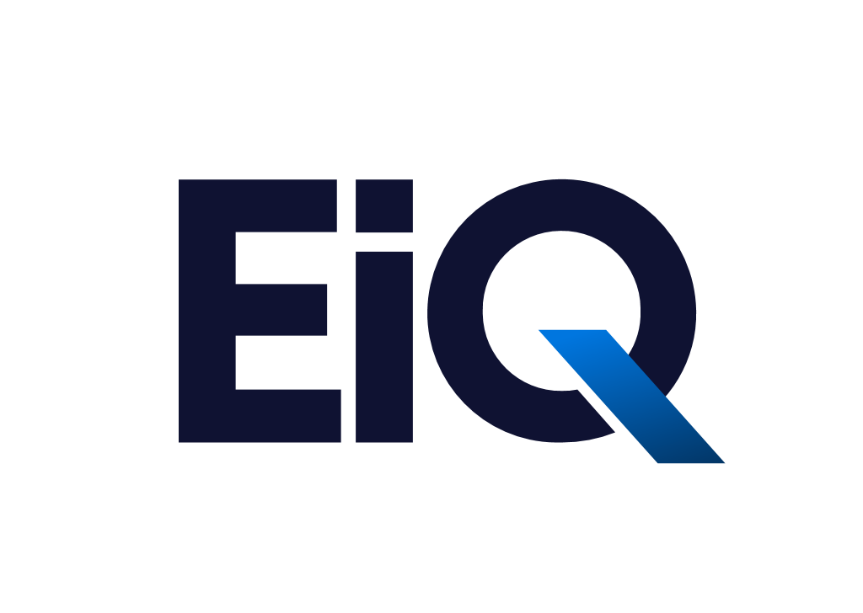
Introducing LRQA
Introducing LRQA
Key Facts
LRQA is a leading global assurance partner, bringing together decades of unrivalled expertise in assessment, advisory, inspection and cybersecurity services – underpinned by data-driven insights – to help its clients navigate a new era of risk.
Operating in more than 160 countries with a team of more than 6,000 people, LRQA’s award-winning compliance, supply chain, cybersecurity and ESG specialists help more than 61,000 clients across almost every sector to anticipate, mitigate and manage risk wherever they operate.
8,000+ colleagues globally
6,000+ technical experts
61k+ clients globally
Operating in 160+ countries
75m+ data points collected In EiQ
Assure assets and management systems
Strengthen cybersecurity maturity
Achieve product integrity
Navigate the energy transition and achieve net zero
Source responsibly
** EiQ is most development for the responsible sourcing solution but is being expanded to all five focus areas.
LRQA Responsible Sourcing: SMETA

Slide 5
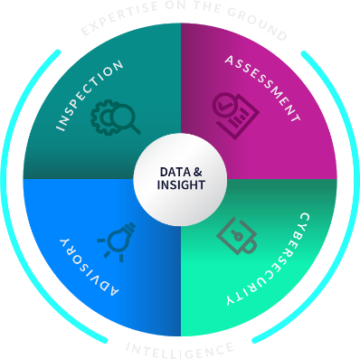
Our connected portfolio of solutions …
We offer a connected portfolio of services to our clients, helping them assure the integrity of their assets and management systems, strengthen cybersecurity maturity, uphold product integrity, navigate the complexities of the energy transition, and source responsibly.
We support clients throughout their compliance journeys and transition to cleaner energy; minimising risk and building confidence in supply chains for a safe and sustainable future.
LRQA is a leading global provider of accredited certification and verification services relating to systems and products, all of which help clients manage their business and supply chain risks.
Product, system & process certification
Technical advisory
Supply chain & vendor Inspections
Transition to cleaner energy
Responsible sourcing & social compliance
Industry standards
ISO Standards
Bespoke programmes
Corporate objectives
We are a global market leader in ESG supply chain advisory solutions, analytics, and training and improvement services. We help clients optimise results, navigate regulatory requirements and transform their supply chain sourcing.
LRQA Nettitude, an award-winning provider of threat-led cybersecurity services, offers technical assurance, consulting, managed detection, and incident response solutions. Serving a wide range of clients, we operate across all industries.
Consulting
Analytics
Training
Programme management
Penetration testing
Managed security services
Incident response
Security risk & consulting
LRQA Responsible Sourcing: SMETA

Slide 6
LRQA’s Responsible Sourcing Services
Section 02
SMETA Services

Slide 7
LRQA’s Responsible Sourcing Credentials
With the acquisition of ELEVATE in 2022, LRQA has expanded its capacity to serve the world’s top brands with human rights due diligence, innovative sustainability solutions and cutting-edge interventions in responsible sourcing
LRQA won the SEDEX Responsible Sourcing Award for Most Innovative Programme in 2017 and 2018 – the only audit firm to receive this award, and the only company to receive this award twice.
First audit firm to integrate mobile phone worker surveys into standard audits (ERSA) using LRQA Laborlink, reaching over 1 million workers since 2021.
Founding member of APSCA, conducting over 30,000 responsible sourcing audits annually.
LRQA’s proprietary Supplemental Data Sheet methodology promotes factory transparency, ensuring continuous improvement despite challenges like labor shortages.
Hosts annual responsible sourcing leadership conference at the New York Stock Exchange
Education is a priority, with our digital learning reaching nearly 1 million learners and the only firm to combine supplier corrective action plan (CAP) reviews with digital learning.
Key partnerships such as our management of the Alliance for Bangladesh Worker Safety, and the US Department of Labor’s Global Trace Protocol.
LRQA serve hundreds of corporate clients with strategic and tactical responsible sourcing advice
LRQA Responsible Sourcing: SMETA

Slide 8












LRQA Responsible Sourcing Accreditations and Memberships
Association for Professional Social Compliance Auditors
Responsible Business Alliance
Nirapon
IDH Electronics Program Assessments
Worldly FEM, FSLM and FDM Program
Social and Labor Convergence Project Assessments
Fair Labor Association Audits
Sustainable Apparel Coalition Higg Verifications
Business Social Compliance Initiative Audits
Sedex Members Ethical Trade Audits (SMETA) 2- and 4-pillar
International Council of Toy Industries CARE Auditing Program
CAFÉ Practices
Ethical Farm Initiative (EFI)
Pharmaceutical Supply Chain Initiative (PSCI)
Worldwide Responsible Accredited Production (WRAP)
LRQA Responsible Sourcing: SMETA

Slide 9
Global Coverage Capabilities
NORTH AMERICA
28
Innovation Centers
198
Processing
EUROPE, MIDDLE
EAST, AFRICA & INDIA
40+
Social Auditors
160+
Non-Social Auditors
20
Innovation Centers
90
Processing
100+
Social Auditors
ASIA PACIFIC
SOUTH AMERICA
1400+
Non-Social Auditors
8
Innovation Centers
4
Innovation Centers
41
19
Processing
Processing
250+
Social Auditors
20+
Social Auditors
530+
Non-Social Auditors
100+
Non-Social Auditors
Updated October 2024
LRQA Responsible Sourcing: SMETA

Slide 10



























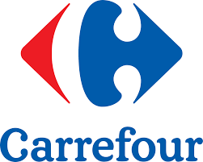



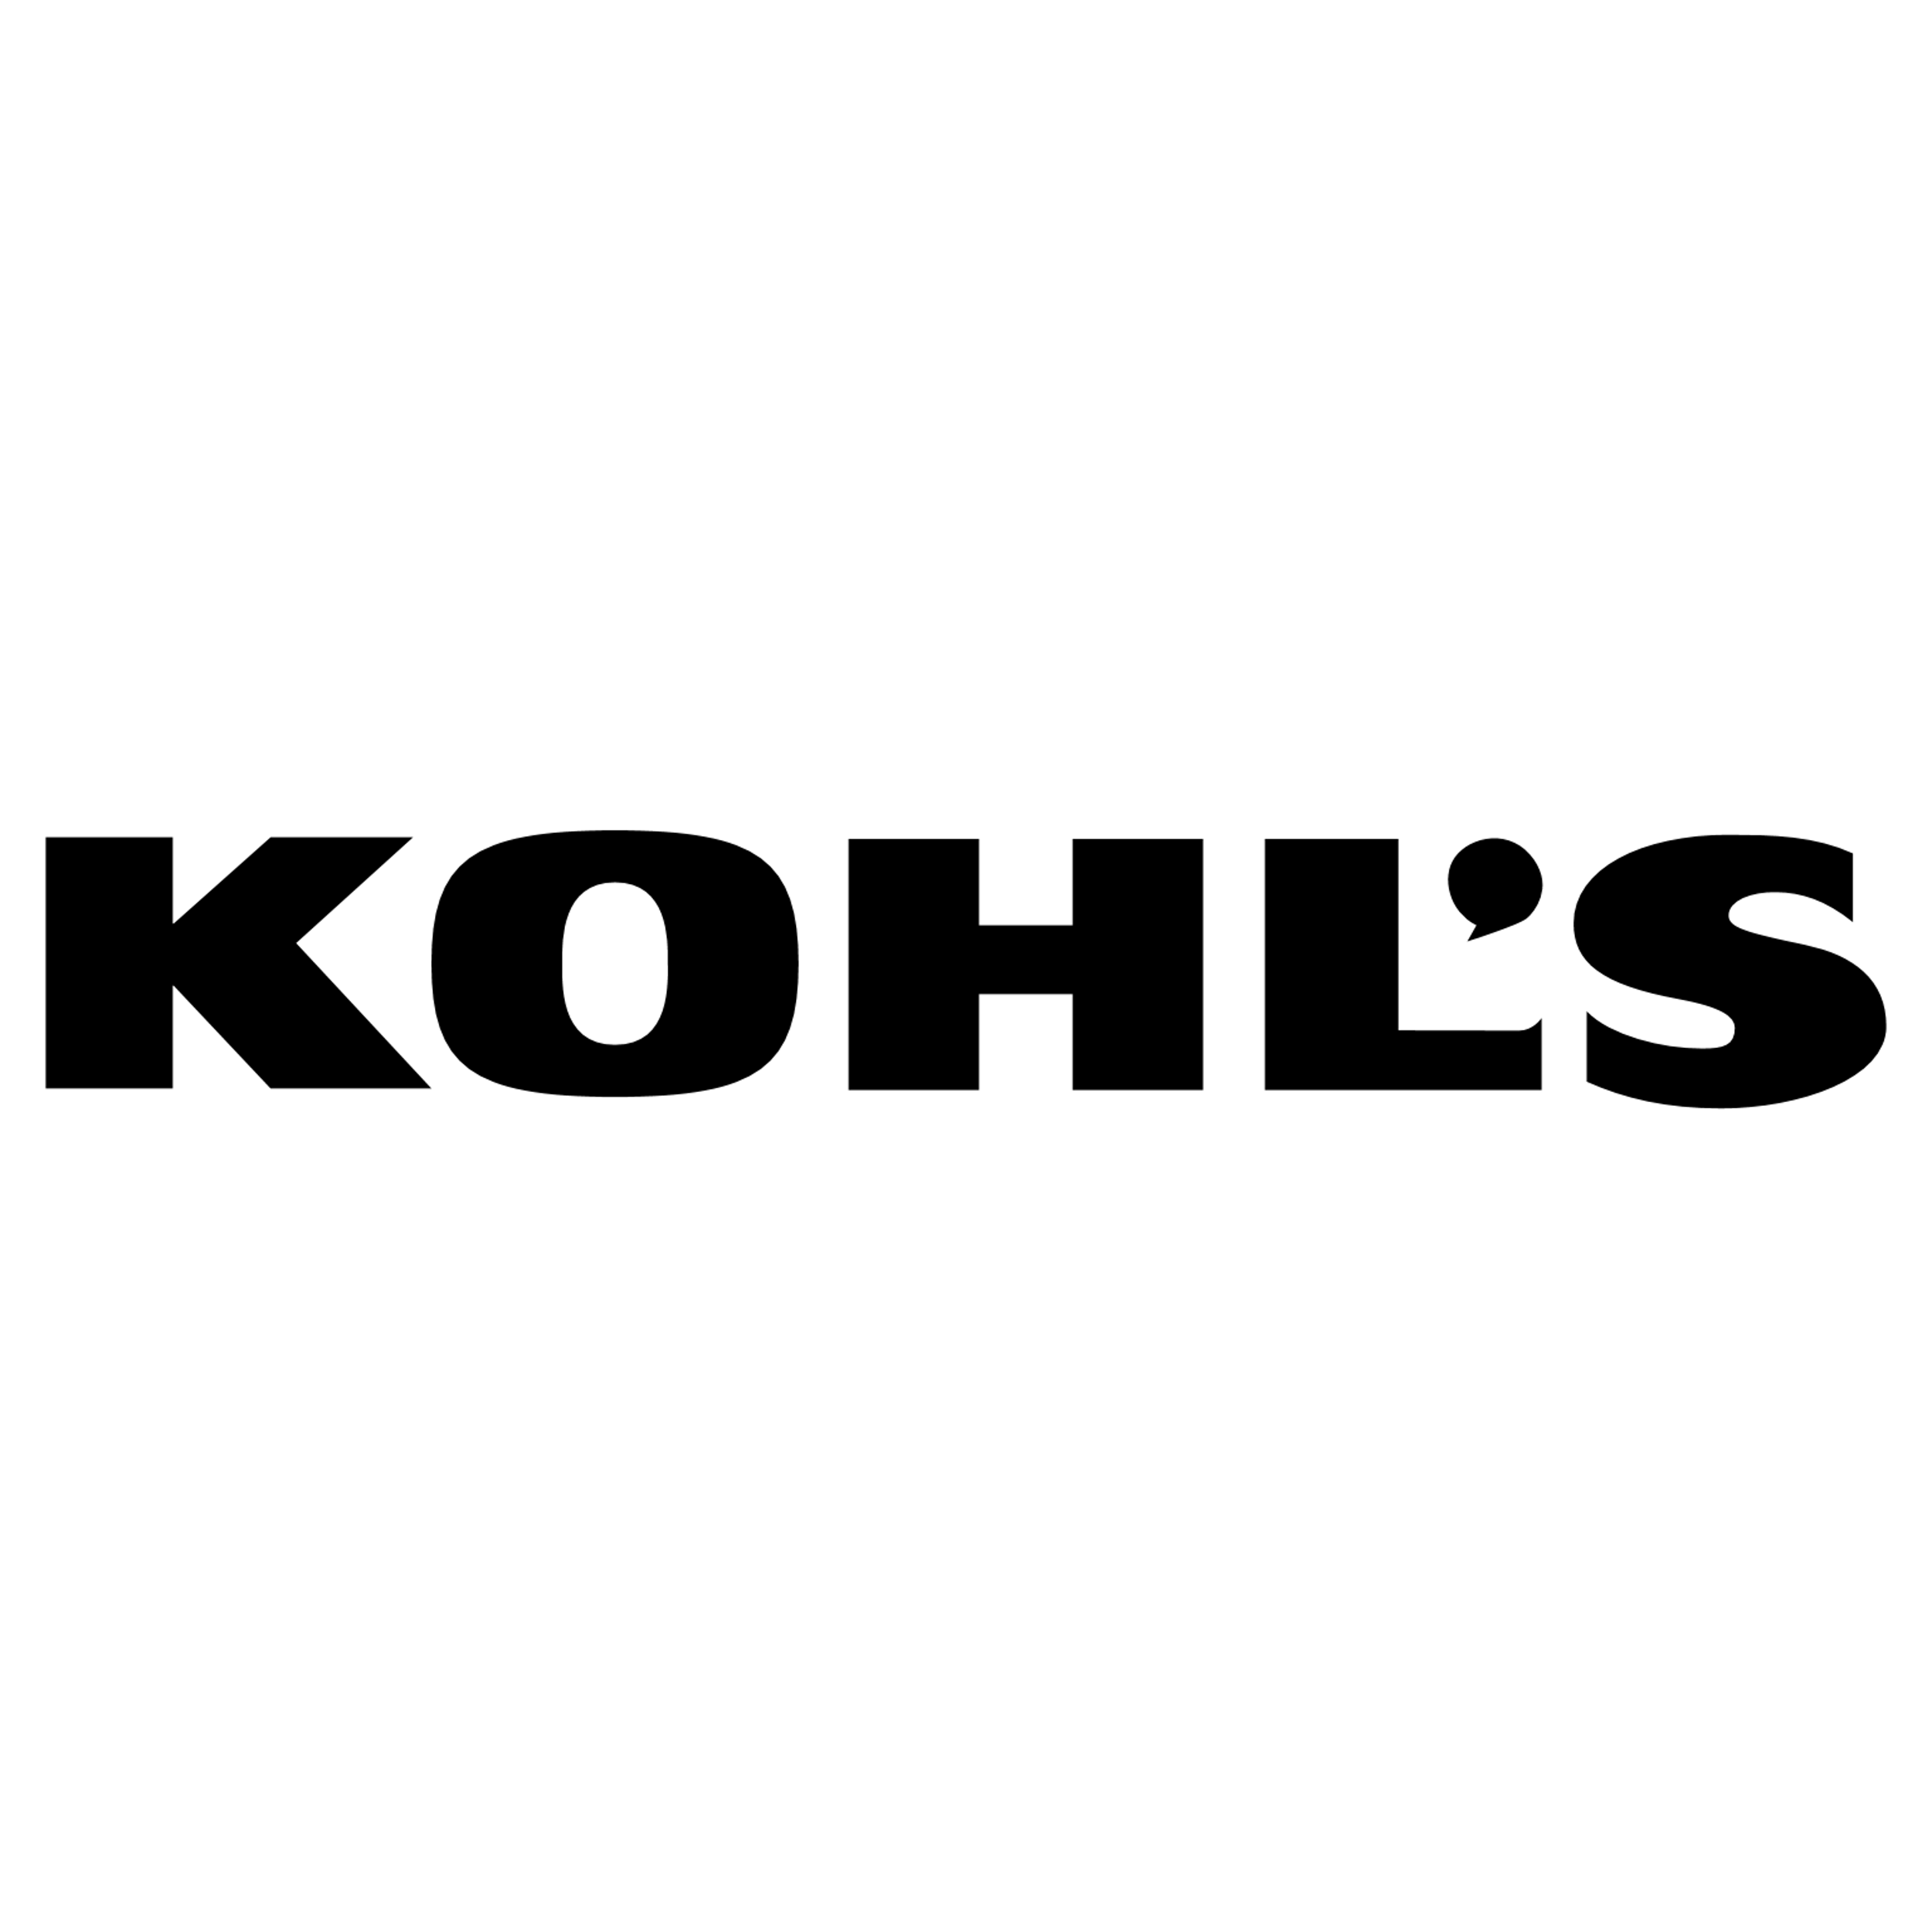














Responsible Sourcing services for the world’s leading brands
LRQA Responsible Sourcing: SMETA

Slide 11
LRQA’s full suite of responsible sourcing support
Diagnostic and Design
Training and Communication
Monitoring
Remediation
0
Diagnostic
1
Supplier Mapping and Screening
2
Risk Assessment
3
Supplier Training
4
Monitoring and Assessments
5
Remediation and Capacity Building
Gap analysis
CoC review / development
Focus areas
Ambition determination
Supply chain risk footprint
Corporate training
Mapping of the supply chain
Screening for:
  Sanction
  Allegations
  Ownership
Media Scanning
ESG Risk Analytics
Traceability and mapping
New and Existing Suppliers
Multi-Tier Intelligence
Investment Prioritization
Smart Program Scheduling
Supplier Segmentation
Code of Conduct Alignment
Contract Alignment
Training on Expectations
Risk Based Training
Audit (Onsite / Remote) (e.g. SMETA)
Equivalency Standards
Supplier Questionnaires (SAQ)
Worker Survey
Grievance Mechanisms and Helplines
Sentinel
Spot Check
CAP Management
Stakeholder facilitation
Root cause analysis
Targeted training
Regular review and consultation
LOW
MEDIUM
HIGH
EXTREME
8
Predictive Management and Business Integration
7
Reporting and Disclosure
6
Regular Review and Peer Benchmarking
Regulatory Requirements
Impact Evaluation
LRQA Responsible Sourcing: SMETA
11

Slide 12
Rolling out a SMETA Audit Program with LRQA
Section 03
LRQA Responsible Sourcing: SMETA

Slide 13
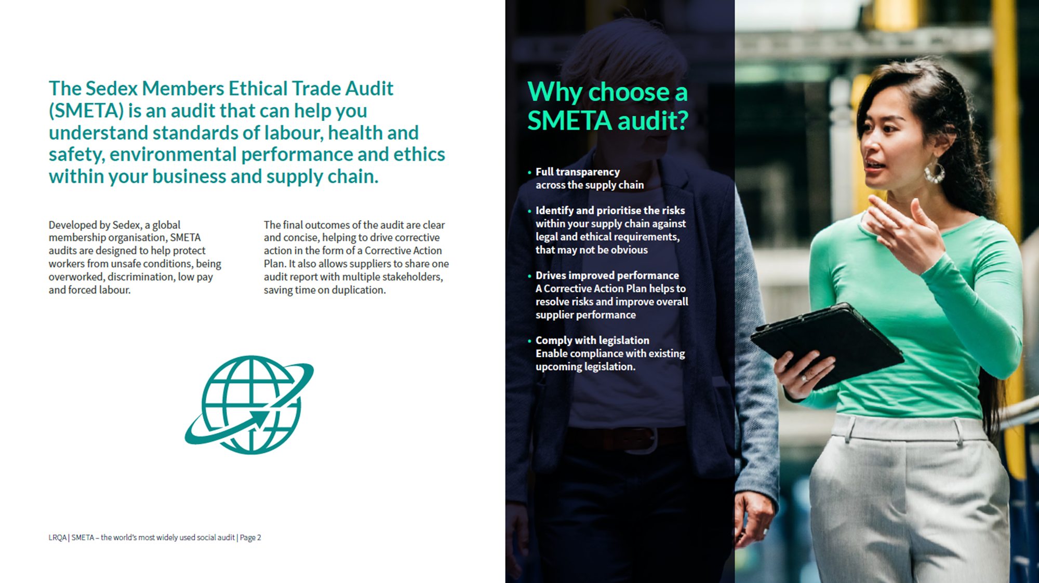
LRQA Responsible Sourcing: SMETA

Slide 14
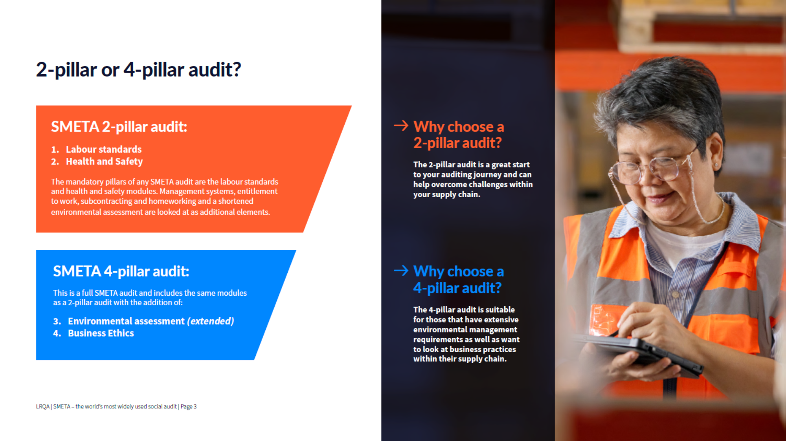
LRQA Responsible Sourcing: SMETA

Slide 15

How is a SMETA Audit deployed?
Ethical or Responsible Sourcing audits typically cover the following topics:
Transparency & Business Integrity
Management Systems
Hiring, Disciplinary & Termination
Child Labor
Forced Labor
Harassment or Abuse
Discrimination
Freedom of Association and Grievance
Foreign Migrant Workers
Wages and Benefits
Hours of Work
Health & Safety
Environment
Subcontractin
Homework
A typical audit follows the below process:
Prepare
Check
Recheck
Complete
Audit Preparation
Factory Tour
Worker Interview*
Closing Meeting
Opening Meeting & Management Interview
Confidential Worker Interviews*
Data Analysis & Cross Checking
Report and Corrective Action Plan Report (CAPR)
Document & Record Review
Analytics (if any)
*LRQA Mobile phone LaborLink survey can also be deployed in a complementing fashion
LRQA Responsible Sourcing: SMETA

Slide 16
SMETA includes LRQA Supplemental Data Sheet (SDS)
As the leading provider, we have built industry-leading processes for securing and analyzing sensitive audit data. Effective data management is critical due to the variety of assessment standards and criteria employed across different industries, brands, retailers and associations globally.
During each social and environmental compliance assessment, LRQA team capture key data points including:
Detailed descriptions of all non-conformance findings, and the categorical classifications of each finding
Supplemental data that provide risk and performance context
Our unified process standardizes data capture to ensure consistency, regardless of the diverse audit criteria encountered.
Note: Available only to direct corporate brands or retailers who are directly commissioning the audit to LRQA.
Finding data
For meaningful cross-assessment analysis, we have implemented a uniform finding capture and storage process - regardless of the original audit standard used.
All findings will be mapped to our proprietary LRQA finding taxonomy categories. They will then be uploaded and stored securely in our centralized database.
The LRQA taxonomy provides a common language, enabling robust analysis and benchmarking across.
Supplemental data
Supplemental data is collected through a form called Supplemental Datasheet (SDS). The SDS contains a standardized set of over 300 data points related to:
Facility profile details
Employee demographics
Performance against key social indicators (e.g. wages and hours)
GHG emission reporting
Regardless of the audit standard or client, our auditors follow the same SDS protocol to collect these supplemental metrics.
LRQA Responsible Sourcing: SMETA
16

Slide 17



SMETA + LRQA SDS: What does it contain?
LRQA’s Supplemental Datasheet (SDS) contains the following:
Worker Interview Feedback
Confidential worker statements that could not be reported in the main report due to the sensitivity of the issue (especially if the site by default obtains a copy of the report).
Transparency Status
Transparency is critical to the assessment process to understand risk, impact to workers and the environment. Without transparency, actions from that point onwards become skewed. LRQA categorizes transparency into three categories:
1
Transparent
2
Inconsistent
3
Inconclusive
Level of transparency on wages and working hours is high.
This conclusion indicates high level of transparency on provided wage and working hour records. The factory is open and transparent.
Level of transparency on wages and working hours is low.
This conclusion indicates the reliability of provided wage and working hour records is low. There are solid evidences noted during the audit.
Level of transparency on wages and working hours is of concern.
This conclusion indicates potential concerns on transparency are noted, mainly subjective information from assessor. However, little or no objective and/or strong evidence is found on-site to proof as a formal violation on transparency.
Auditor Feedback
Subjective or supplementary information that LRQA team feel is important to put context around, including but not limited to for example suspicions of falsification of documents and child labour. These are information we want to make client aware off, even if there has no objective evidence found.
Quantitative Data Points
The SDS report also includes 300+ different quantitative data points on different subjects that LRQA auditors collect onsite. The data points help our team benchmark each site against other local sites, but also informs our internal auditor integrity program.
LRQA Responsible Sourcing: SMETA
17

Slide 18
SMETA Scheduling Process
LRQA sends Introduction to site
  Propose Audit Dates
  Explain audit process
  Request review (and signature) of key documentation
Site to review introduction
  Review & Return Signed Signed Code of Ethics
  Send back completed facility profile
  Review Non-Retaliation Policy
  Review Client Related Documentation
Site to confirm audits & LRQA send confirmation email
  Country Based Document List
  Audit Agenda
Request Sent to LRQA
LRQA Responsible Sourcing: SMETA

Slide 19
SMETA Sample Timeline
Request Submitted
Onsite Assessment
Report Writing
Report Submission
CAPR Desktop Review
  Propose dates
  Confirm dates
  Interviews
  Document & record review
  Site observation
  Draft CAP
  Write report
  ZT Alert (where applicable)
  Report review
  Final report
  Direct to client
  SMETA upload
  CAP Initiation
  With supplier
  Digital Learning
Turnaround Time from request to scheduling depends on country (30-90 days)
1-4 days depending on sample
7-10 days
Completion
30-90 days depending on customer
LRQA Responsible Sourcing: SMETA

Slide 20




LRQA’s SDS quantitative data coverage
The SDS report also includes 300+ different quantitative data points on different subjects that LRQA auditors collect onsite. The data points help our team benchmark each site against other local sites, but also informs our internal auditor integrity program.
    Site Profile
    Business license #
    Sector and products
    Seasonality of business
    Processes
    Supporting facilities (e.g. cooking or dinning areas and dormitory)
    Other tenants sharing the facility
    Est. % business represented by the client
    Production output
Employee Information
    Employee breakdown by
    Position
    Gender
    Place of origin
    Languages spoken at the site
    Use of labor agents
    Worker age profile
    Compliance Performance
    Transparency status
    Wages and hours
    Avg. and max. recruitment fees paid by workers
    Sampling details for hours and wages
    Freedom of association
    Worker interview notations
    Internal assessor note
Other Data Points
    Current certification / programs
    Subcontractors
    Energy consumption and GHG emissions
      23 energy types including both renewable and non-renewable energy types
      Consumption volume
      Refrigerants
LRQA Responsible Sourcing: SMETA
20

Slide 21
Managing SMETA Corrective Action Plans and Supplier Improvement
Section 04
SMETA Services

Slide 22
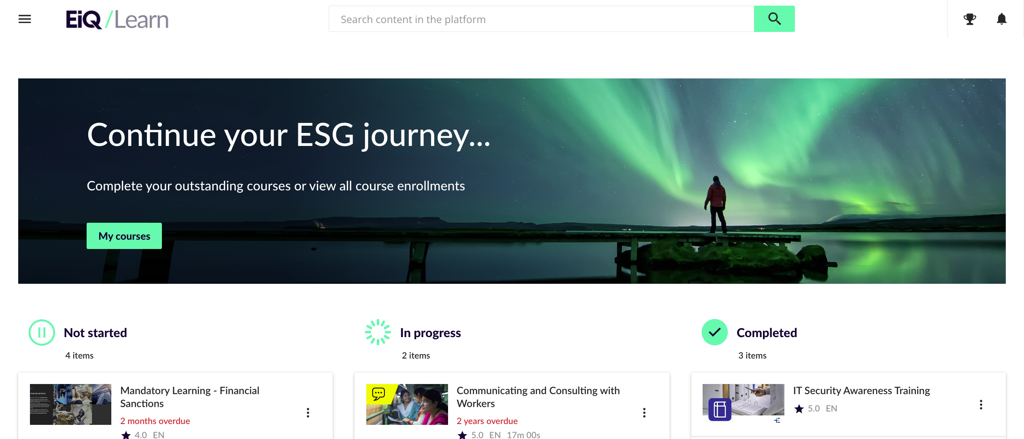
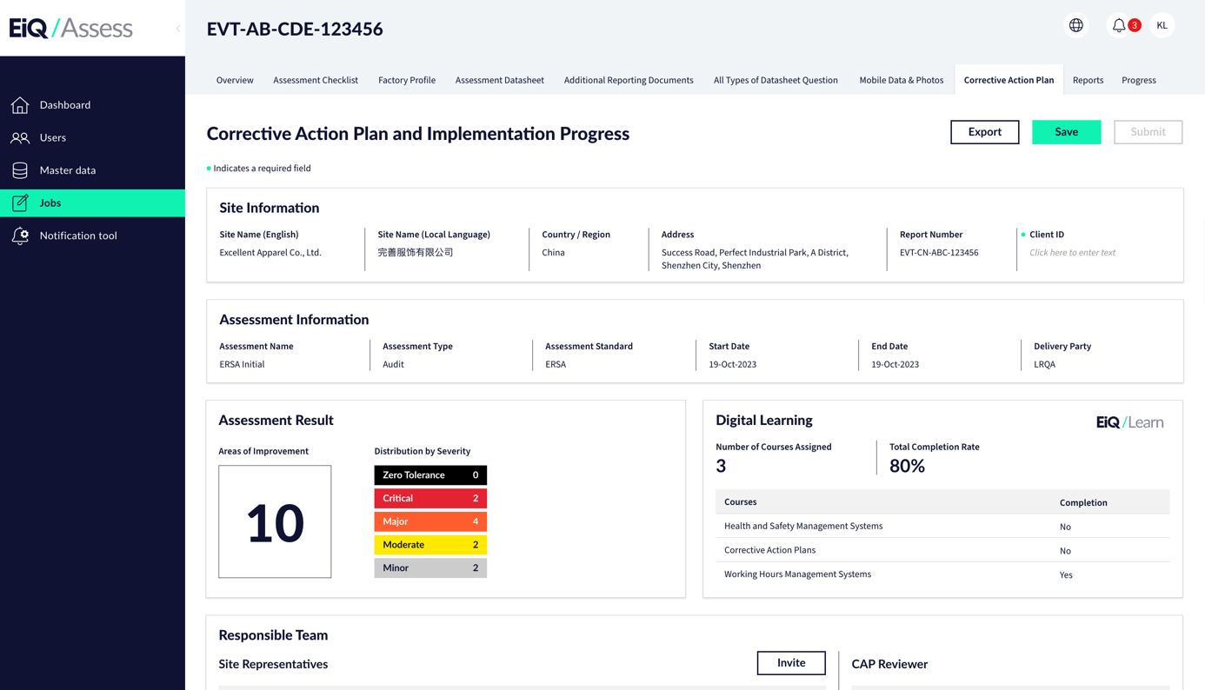
Corrective Action Plan (CAP) management: Overview
Corrective Action Plan Management (CAP) refers to the process of developing, implementing, tracking and closing out corrective actions in response to identified nonconformities, issues or deficiencies found in a particular assessment.
Common Challenges:
Tendency for the process to degrade into a “box-ticking” exercise
Lack of integrated systems forces manual repetition that bogs teams down in paperwork instead of progress, discouraging participation.
Without digital visibility and tracking, the actual impacts - or lack thereof - of corrective actions may not be evident to all stakeholders involved.
Fragmented reports makes it challenging for internal and/or external reporting
Our Solution:
Defies the “one size fits all” paradigm for CAP. LRQA's approach segments actions according to individual audit results for greatest efficacy and efficiency.
It taps LRQA’s extensive digital learning resources to provide tailored and targeted training for each supplier.
Utilizes our in-house digital platform for suppliers to report on their remediation updates and associated evidence on a real-time basis during the CAP process.
Client Portal that houses and presents due diligence activities data in one place
LRQA Responsible Sourcing: SMETA

Slide 23



LRQA’s CAP Management Services
CAP
Development Support
CAP
Desktop Evidence Review
CAP
Development and Evidence Review
This service assists auditees in creating corrective action plans (CAPs) to address nonconformities identified during assessments.
Key elements include:
Providing LRQA digital learning courses that take auditees through common root cause analysis frameworks like 5 Whys and Fishbone Diagrams.
Evaluating proposed corrective actions to ensure they are not just addressing surface-level symptoms.
Monitoring progress and provide status updates to ensure CAP development stay on schedule.
This service reviews the evidence submitted remotely by the auditee to assess implementation of corrective action plans as defined in the CAP.
Key elements include:
Providing LRQA digital learning courses that educate auditees on topics based on findings
The review focuses solely on the evidence submitted by the auditee, such as remediation photos, updated procedures or training records.
The review may not be able to verify with certainty that identified root causes were effectively addressed, as this depends on the evidence.
This combined service provides CAP development support and desktop evidence review.
Key elements include:
Providing LRQA digital learning courses that take auditees through common root cause analysis frameworks like 5 Whys and Fishbone Diagrams.
Evaluating proposed corrective actions and monitoring progress to ensure CAP development stay on schedule.
Reviewing the evidence submitted by the auditee, such as remediation photos, updated procedures or training records.
It does not include:
Review remediation evidence
Provide our viewpoint / determination on CAP implementation status (e.g. close findings)
It does not include:
Review the CAP developed
Provide feedback on the quality of action plans
LRQA Responsible Sourcing: SMETA
Notes:
Dev Support / ER Limitation and deliverables

Slide 24

LRQA’s CAP Management Services
Service Overview
Items | CAP Development Support | CAP Desktop Evidence Review | CAP Development and Evidence Review
When to Start by default | 5 calendar days after the completion of audit (report issued)* | 15 calendar days after the completion of audit (report issued)* | 5 calendar days after the completion of audit (report issued)*
Duration of Service | 45 calendar days | 45 calendar days | 90 calendar days
# Rounds of Interaction | 3 | 3 | 6
Access to LRQA Digital Learning Course
(Add-on) Worker Survey
Report Submission
45 days
CAP Development
Report Submission
45 days
CAP Desktop Evidence Review
Report Submission
45 days
CAP Development
45 days
CAP Desktop Evidence Review
5 days
Site to digest the report
15 days
CAP development & preparation
5 days
Site to digest the report
* Our suggested timeline to auto-initiate CAP service after LRQA assessment, when CAP service is booked with the assessment by default. Subject to client program design.
LRQA Responsible Sourcing: SMETA

Slide 25

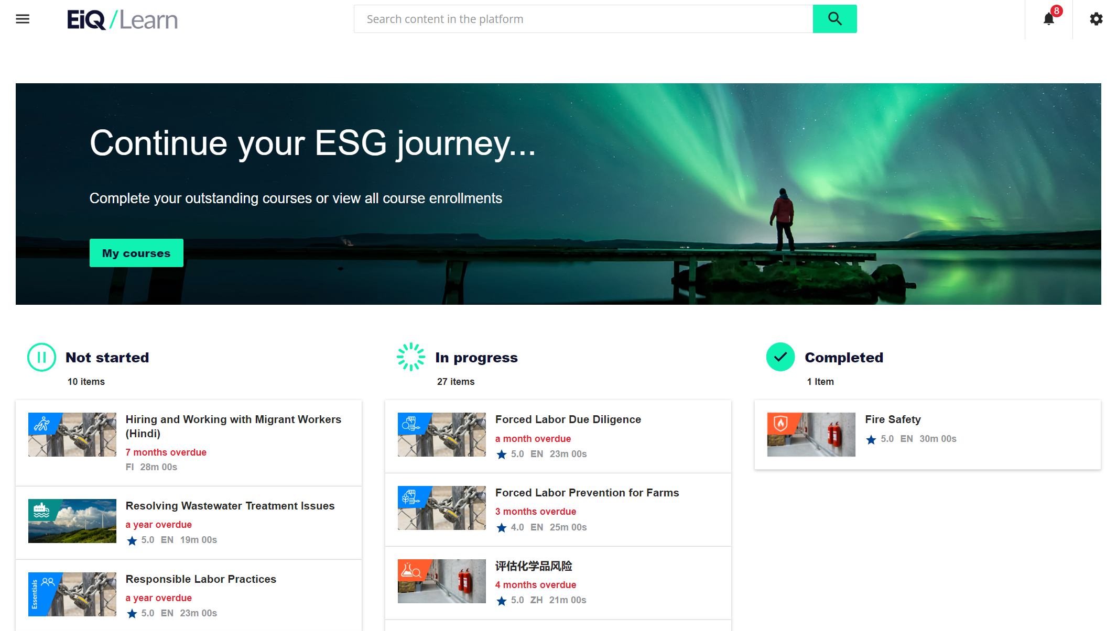






CAP Management with Digital Learning
LRQA’s EiQ Learn: the digital home of supply chain ESG training
EiQ Learn is a comprehensive learning management system and eLearning course library designed specifically for supply chains.
Our course library includes hundreds of interactive, animated courses that help businesses understand their ESG risks, promote sustainable and compliant practices throughout the supply chain and remediate issues where they are found. Through EiQ Learn, you can independently manage your digital supply chain training programmes.
Scalable
Trackable
Cost-effective
Standardized
Efficient
Engaging
LRQA Responsible Sourcing: SMETA

Slide 26



LRQA supports CAPs with Digital Learning
Our comprehensive course library covers a variety of responsible sourcing and business assurance topics
Target audience |  | Course topics (with Essentials)
Manufacturers and Producers Site managers and supervisors Vendors Sourcing, procurement and supplier management teams Service Providers Management teams Brands & Retailers Sourcing, procurement and supplier management teams |  | Responsible Sourcing Transparency and Business Ethics Management Systems Hiring, Disciplinary Practices and Termination Young Workers and Child Labour Forced Labour and Migrant Workers Harassment and Abuse Non-discrimination Freedom of Association & Grievance Mechanisms Wages and Benefits Hours of Work | Health and Safety Environment Subcontracting and Homework Supplier Management Legislation and Initiatives Quality Management Business Assurance (coming soon) Management Systems Product Integrity Cyber Resilience Energy Transition
Course languages
All courses are available in English and Mandarin Chinese. Select courses also available in Spanish, Vietnamese, Japanese, Bengali, French, Hindi, Italian, Portuguese and more.
See the full course list here.
LRQA Responsible Sourcing: SMETA

Slide 27
LRQA’s unique CAP + Digital Learning
Our research shows a strong correlation between “first time right” / completeness of CAPs with suppliers that take targeted digital learning lessons
LRQA Responsible Sourcing: SMETA

Slide 28
Other Training and Improvement Services for Suppliers
It is critical to ensure your suppliers have the knowledge and resources to address key risks highlighted in your due diligence and work toward continual improvement.
Digital Learning
  Leverage a learning management system and/or eLearning course library designed to meet your ESG objectives
  On-demand training helps suppliers understand why and how to address key ESG concerns that your company monitors
  Digital learning can be used to remediate common compliance violations and respond to key risks uncovered by surveys and/or grievances raised
On-site engagement
  This effective, educational approach helps identify key gaps in performance and management systems, and provides sites with toolkits and expertise to implement sustainable changes
  On-the-ground consultants can facilitate improved workforce management, production, quality, cost, compliance and management training
  This engagement should include a comprehensive report provided to your company that highlights the human rights impact this poses to your supply chain
Root cause analysis
  Structured problem-solving method that is aimed at uncovering the fundamental root causes of an issue or problem, rather than just addressing its symptoms.
  Helps organizations and individuals prevent the recurrence of problems by addressing their core causes, leading to more effective and sustainable solutions.
Responsible Recruitment Programs and Recruitment Fee Investigations
  Labor/employment agencies are often overlooked in supply chains, posing unforeseen human rights risks specifically with some of the highest-risk workers in the supply chain
  This approach provides guidance on how plants can recruit workers in ways that do not place their human rights at risk
  Identifies high-risk labor recruiters and brokers, and screens responsible recruitment partners
  Interviews workers to ensure no recruitment fees or deceptive practices have been used
  Work to mitigate risk by helping your supplier develop responsible recruitment policies and procedures
LRQA Responsible Sourcing: SMETA

Slide 29
Managing the Program: Platforms and Analytics
Section 05
LRQA Responsible Sourcing: SMETA

Slide 30

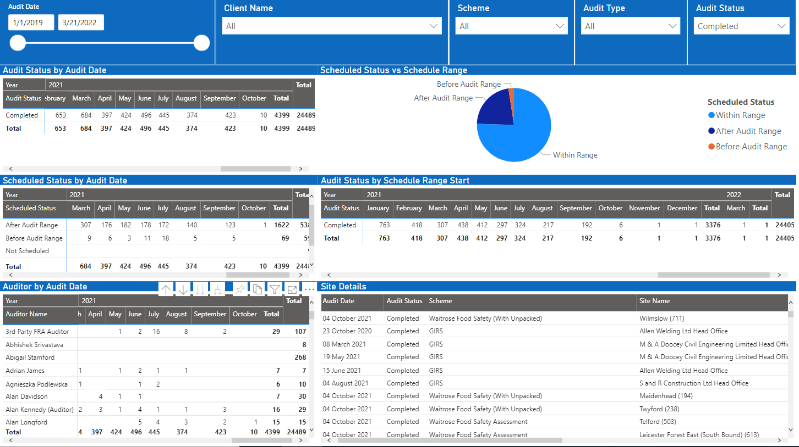

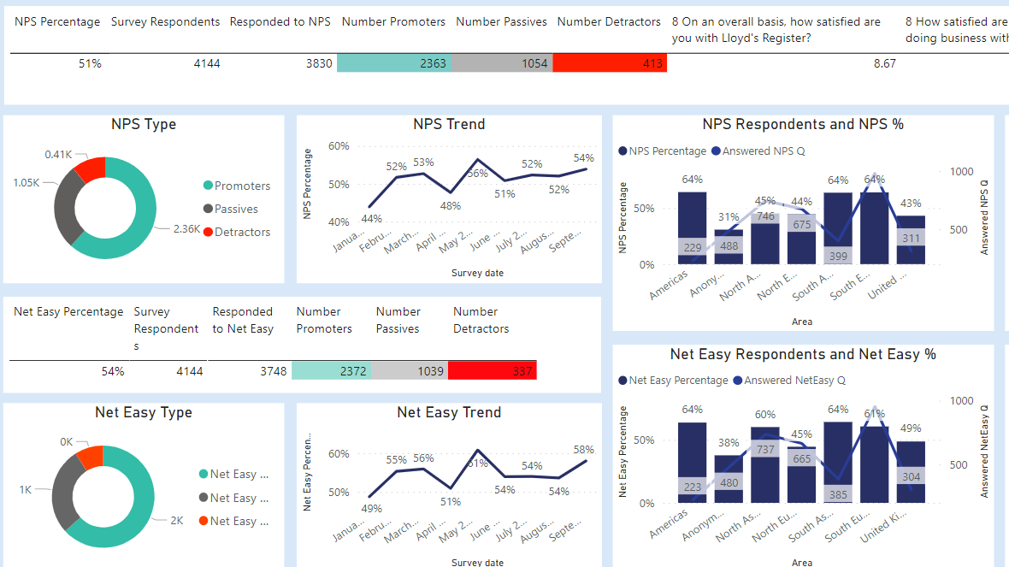
Measuring up to client expectations through LRQA technologies & innovation
By tracking our own performance, we provide our customers
with the very best service. Using advanced reporting through
Power BI, we monitor performance against agreed KPIs, giving
our customers complete transparency and focus.
Client Portal
Simple to use, 24/7 application – easy access for sites and corporate teams
Accessibility of data
Enabling the speed of response
our clients expect
Dedicated resource
A direct point of contact to provide the information you need
Task tracking & monitoring
Real-time visibility and reporting
of the certification process
Review and reporting
Data-driven review meetings, tailored to your requirements
Continuous development
Accessing our expertise and data
to drive your business forward
LRQA Responsible Sourcing: SMETA

Slide 31
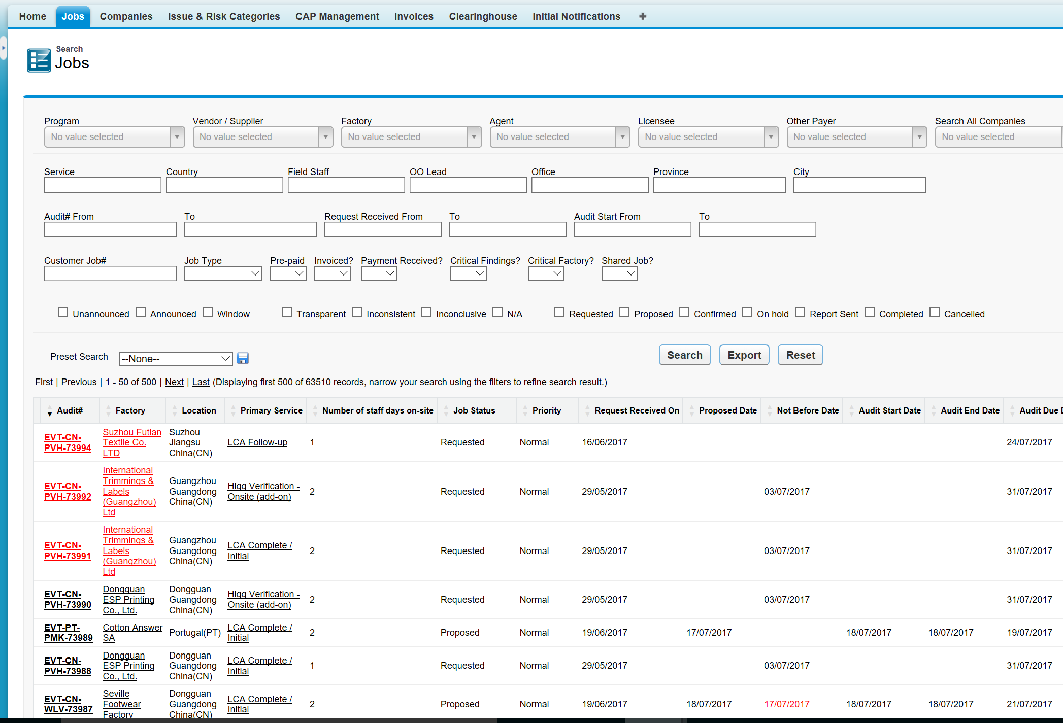
LRQA Client Portal (Aruvio)
Responsible Sourcing audit clients have access to our Client Portal for jobs (Aruvio) and managing CAPs (EiQ Assess)
Full visibility of planned and completed visits. As well ability to confirm proposed audit dates.
Securely download documents related to your audits with LRQA
Data links to PowerBi for your account manager to support analytics
Links to CAP statuses, managed in complementing system
View, reply and follow the status of audit findings
Generate quotes and add purchase order numbers for you visits
Contact LRQA and follow the status of your request
LRQA Responsible Sourcing: SMETA

Slide 32
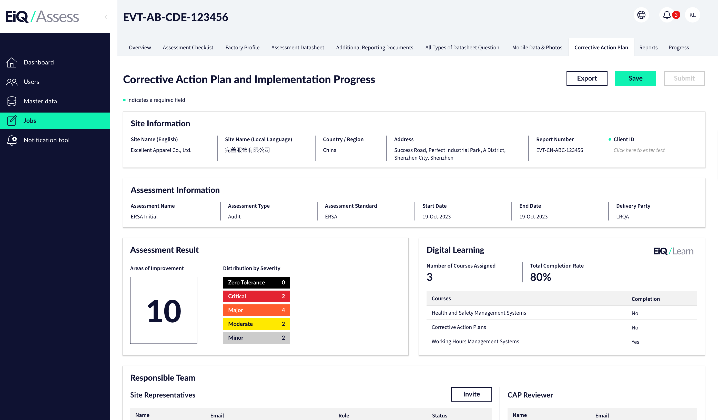

LRQA Client Portal: CAP Management
Function to export, save and submit
CAP / updates.
Basic site information
Assessment information (incl. audit, SAQ and WSS)
Assessment result to inform the scope of CAP
Summary of digital learning status,
and the single log-on to enter EiQ Learn
LRQA Responsible Sourcing: SMETA

Slide 33
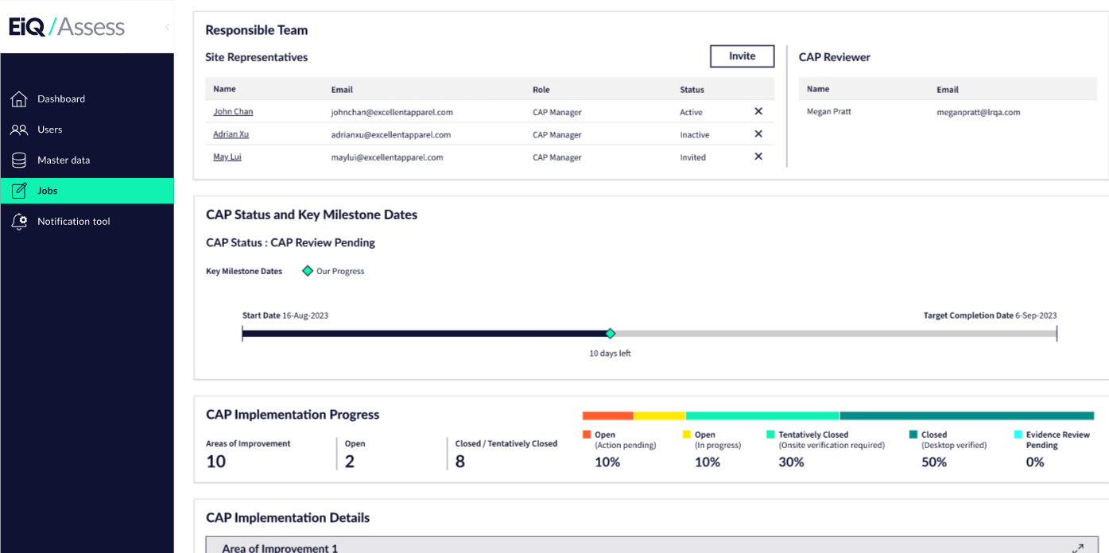
LRQA Client Portal: CAP Management
Responsible team from both site and LRQA side. Enable sites to invite others to join the CAP process.
CAP status and the journey, indicating target completion date and the latest status
Summary of CAP progress with breakdown by finding level details
LRQA Responsible Sourcing: SMETA

Slide 34
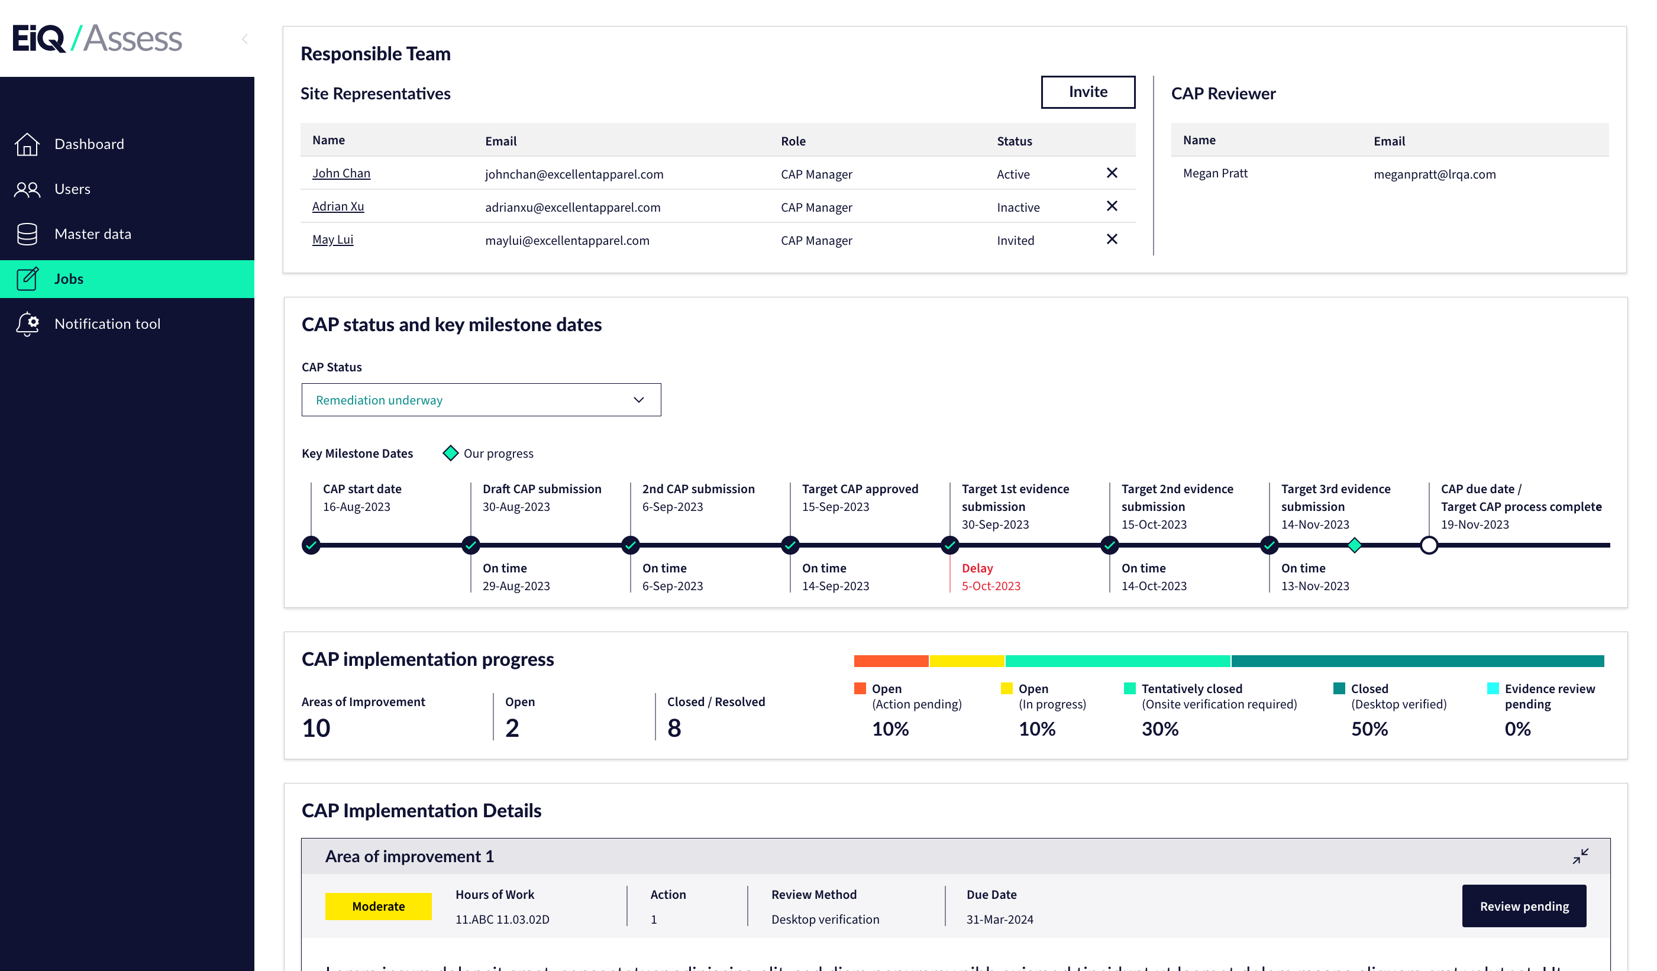
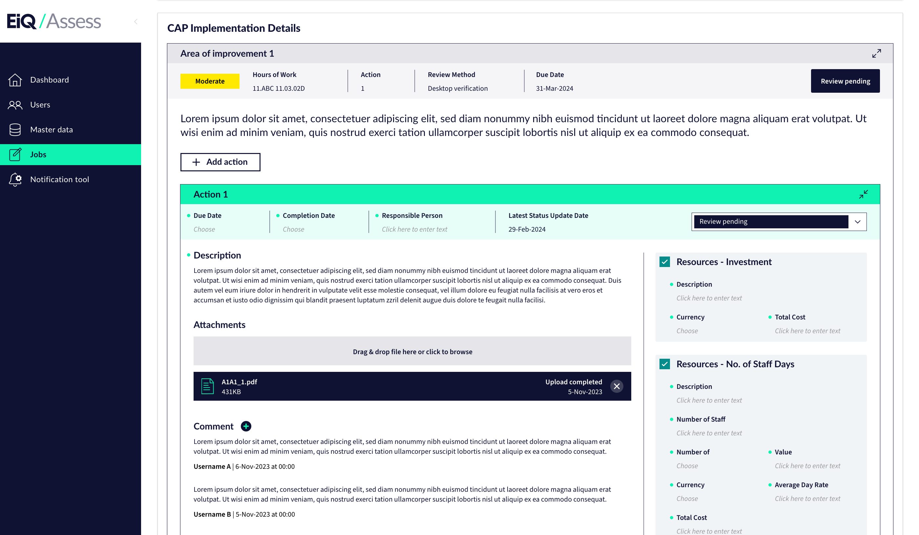
LRQA Client Portal: CAP Management
Expandable finding box
Violation and severity
# actions
Review method (default)
Due date (Automated based on the actions)
Status (Automate based on the actions)
Expandable action box
Action item
Due date
Completion date
Responsible person
Latest update date
Attachments
Comments (from site and CAP managers)
Cost of remediation
LRQA Responsible Sourcing: SMETA

Slide 35
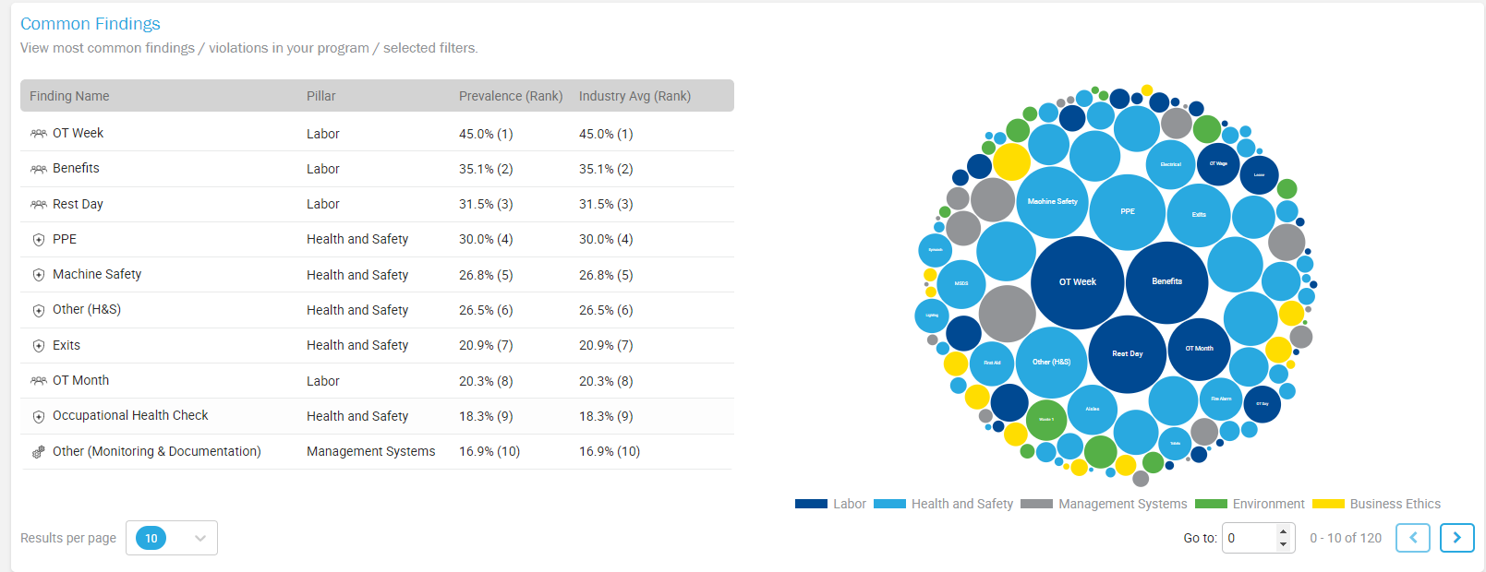
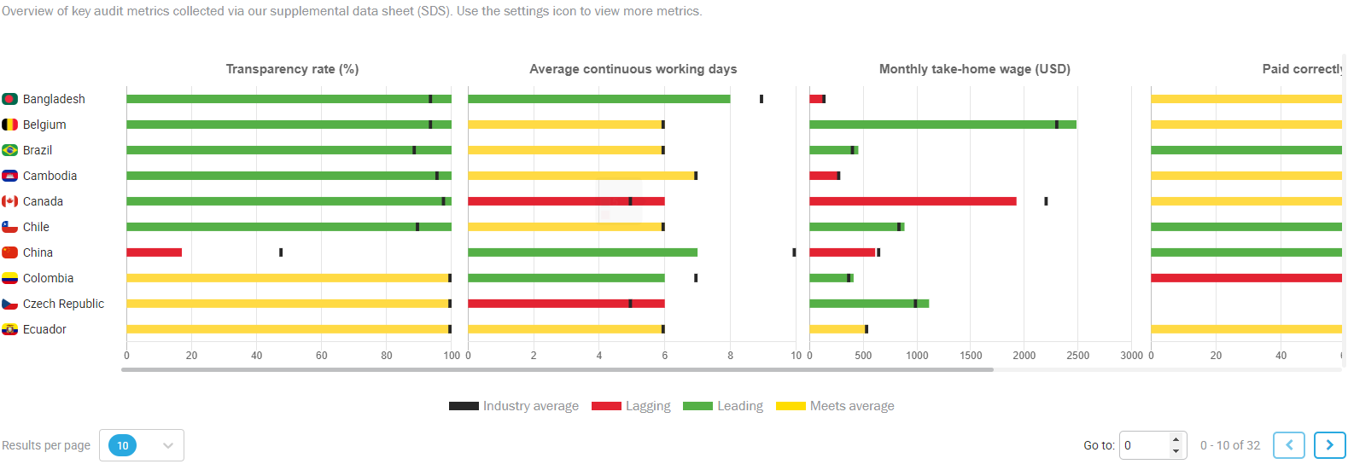
LRQA Program Analytics (PowerBI)
Common Findings
EiQ empowers clients to see benchmarking against industry and country average in terms of:
Common violations observed during assessments
Key quantitative metrics incl:
  Transparency rate
  Average monthly take-home wages
  Average % of workers paid correctly
  Average / highest weekly hours
  Average continuous working days
  Etc.
YoY trends
Clients can filter the data to fulfil various internal and external reporting requirements:
By country
By sector
By defined reporting time period
By vendors
By leverage
Etc.
Audit Metrics
LRQA Responsible Sourcing: SMETA

Slide 36
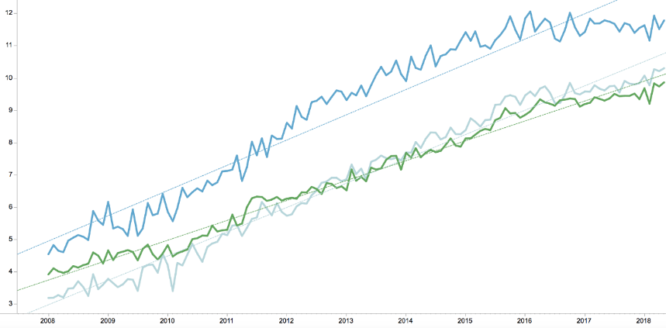
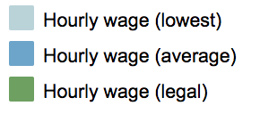

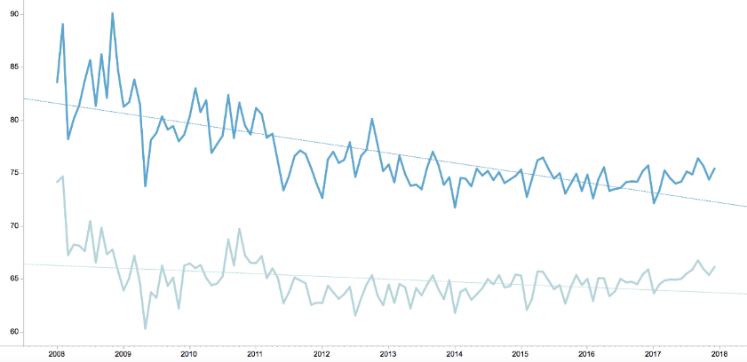
LRQA Program Analytics (PowerBI)
China
China
12
85
65
3
Workplaces are getting better. People’s lives are improving
Working hours are coming down. Together impacts margins …
LRQA Responsible Sourcing: SMETA
Notes:
V

Slide 37
Account Management
Section 06
SMETA Services

Slide 38
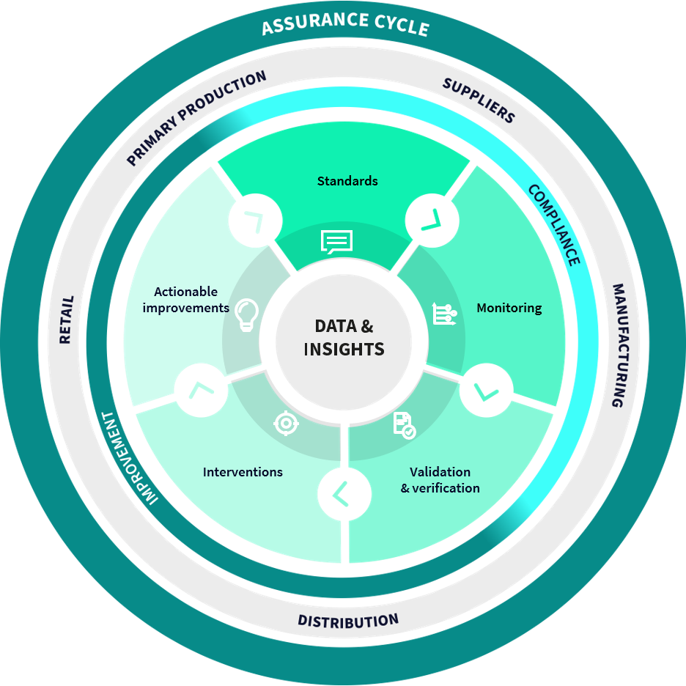

Account Management designed around you
Why is LRQA our business assurance partner? Because they have
a partnership approach, walking hand-in-hand with us into the future.
They have a true understanding of our business, take the time
to consider our challenges, and don’t wait to be asked.
SVP of QF&S Confectionary Company
We get to
know you…
Investing time to fully understand your business, its goals and assurance maturity
…investing in innovation…
Specialist project teams use expertise and digital tools to outline customized, measurable solutions
… and monitoring progress…
Helping you, measuring validated progress and use data for meaningful improvements
…to identify areas of focus.
Exploring risks, solving problems and implementing improvements together
38
Notes:
Our Global Account approach works as it was designed with you in mind.

Slide 39



Our People: Account Management
Organization of LRQA Global Account . This basic model can be adapted to mirror your own organization and expectations.
Executive Sponsor
Customer
Account Manager
Client Support Manager
Technical Account Manager
Local Client Relationship
Coordination, Auditing, Report Review
Resource Pool
Audit Locations
Local
Auditors
LRQA Responsible Sourcing: SMETA

Slide 40

Our People: Auditor Quality First
Auditor Competency
  Bachelor or MSc and minimum 4 years of work experience
  Lead Auditor training and APSCA Qualification
  An average of 3 months supervised training in the field (Witness Audits)
  Qualification per sector based on working experience and
  specific knowledge in products and processes
  Annual scheme calibration
Auditor Code of Conduct
Internal training and evaluation of auditors
  Briefings with client expectations
  Harmonization sessions
  Technical Reviews include finding and root cause analysis review
  Process procedures in shared location
  Field Desktop Review every 2 years by Auditor Manager
  Field Review every 3 years (Witness audits)
Customer Specific Training
  Understanding Customer’s business and requirements "Field Instructions"
Technical Lead
responsible for delivery of supplier audit programs, overseeing the quality and governance of the LRQA's auditors
LRQA Responsible Sourcing: SMETA

Slide 41
Worker Surveys
Optional
Customer Responsible Sourcing Program

Slide 42






Deploy a Worker Survey
10+ years experiences in industrial-level worker survey engagement
Globally recognized organization excelling in strategic survey programs
Founding member of the WEST principles for worker engagement
Part of a wider consulting business with extensive capacity-building services
Established regional partnerships with trusted NGOs and local organizations linked to worker communities
Preferred partner for leading global associations and industry groups, spearheading impactful programs to amplify worker voice
NOTE: Worker survey service was formerly under the brand name of Laborlink, which was acquired by ELEVATE in 2017 and LRQA in 2022.
Key highlights
(Recent 3 years, 2020-2022)
62
Countries covered
10K
55
Surveys deployed
Languages supported
7M+
30M+
Workers engaged
Data points generated

Slide 43
Standardized Worker Surveys by LRQA
Worker Sentiment Survey | Labour Risk Survey | Grievance Mechanism Survey | Critical Issues Survey
4 Sentiment dimensions | 11 ILO force labour indicators | 8 UNGP GM effectiveness criteria | 10 ERSA critical non-compliance categories
Labor Health & Safety Environment Management Systems | Abuse of vulnerability Deception Restriction of movement Isolation Physical and sexual violence Intimidation and threats Retention of identity documents Withholding of wages Debt bondage Abusive working and living conditions Excessive overtime | Accessible Predictable Equitable Transparent Legitimate Rights-compatible Source of continuous learning Engagement and dialogue | Building integrity Child labour Discrimination Dormitories Egress and evacuation Forced labour and human trafficking Freedom of association and grievance Harassment and abuse Monitoring and compliance Wages and benefits

Slide 44
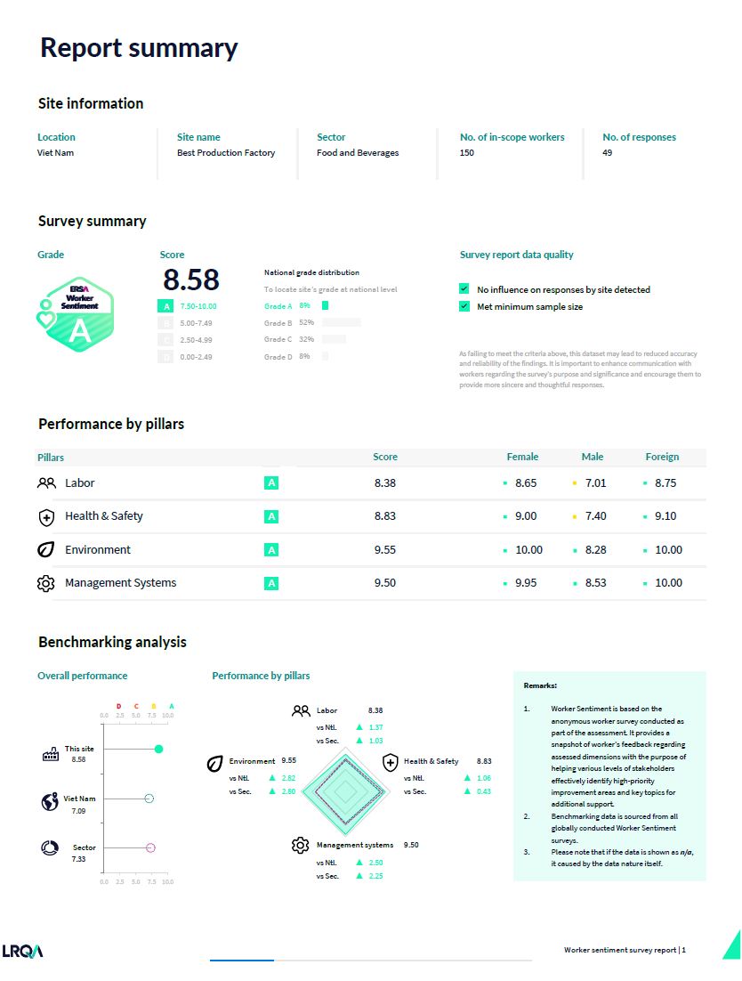
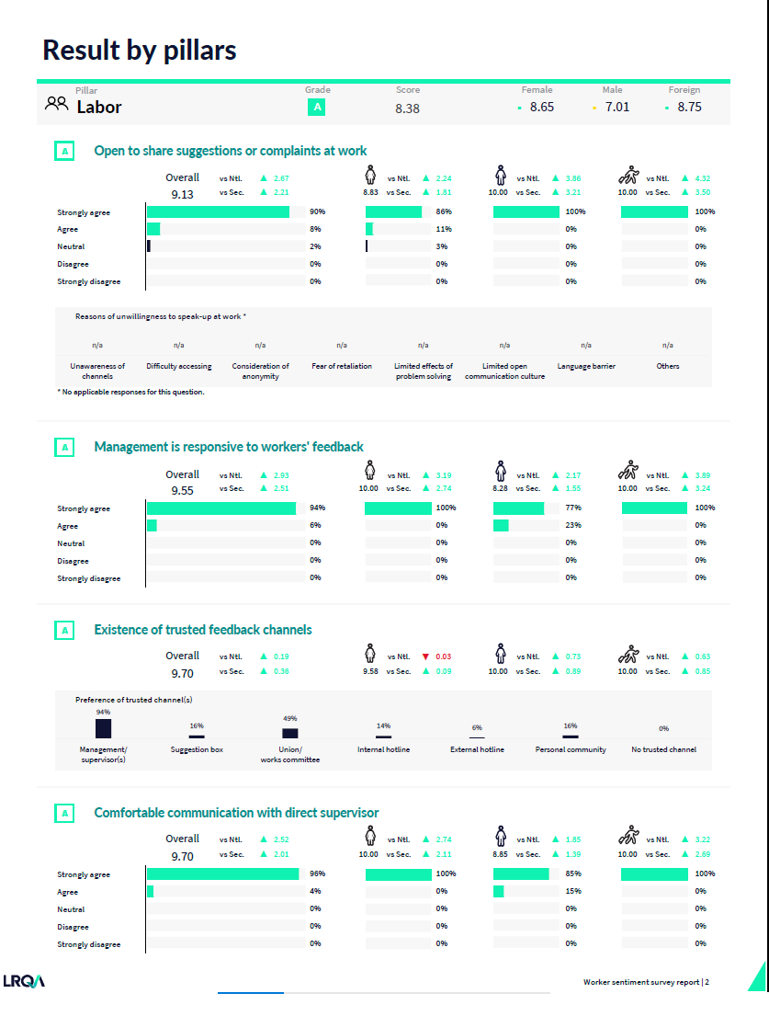
Worker Survey Reports
Capture meaningful data effectively with user-friendly visualizations
An aligned design mindset has been adopted across four focused survey reports to provide clients with a unified view of survey results.
Typical content of Worker Sentiment Survey as reference:
Report summary
  General survey and site information
  Overall grade and score
  Performance of dimensions
  Benchmarking analysis to nation and/or sector
  Result details
  Grade, score and benchmarking by question level
  Breakdown of response % for each question
  Gender and migrant specific response %
  Endnotes
  Recommendations
  Survey responses demographics
44

Slide 45
Worker Survey + SMETA: Greater Insights
What we found in audits (no survey)…
… versus what additional evidence comes from utilizing LaborLink Mobile Surveys
1 Harassment Incident confirmed; 27 Harassment Policy Related findings (China)
% Workers have experienced or witnessed unwelcome sexual remarks or physical contact by a coworker or superior in the 12 month period (China)
Customer Responsible Sourcing Program

Slide 46
Program Design: Supplier Segmentation and Risk Assessment
Option
SMETA Services

Slide 47



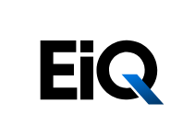

Building the foundation for any Customer requires understanding the current state of due diligence management systems and the exposure to risks in the supply chain
Inputs
Process
Outputs
1. Current State Assessment
3. Recommendations & Roadmap
We will develop a set of recommendations and the implementation roadmap. It will include the short-, medium- and long-term action items to enhance / develop the due diligence and responsible sourcing program, aligned with the company’s level of ambition and compliant with regulations.
The recommendations will consider supplier prioritization and allow better allocation of resources
Regulatory Landscape
Mapping
We will review the program against 5 pillars:
Strategy & Commitment
Internal Alignment & Governance
Supply Chain Mapping &
Transparency
Engagement & Tracking Performance
Communicating & Reporting
Management Systems & Document Review
Internal Stakeholder Engagement
2. Risk Analysis
We will prioritize the suppliers based on:
Risk Exposure
Leverage for Client
Supply Chain Data
Client Supply Chain Data
Customer Responsible Sourcing Program

Slide 48
LRQA will conduct a Supplier Segmentation and Risk Assessment
The segmentation approach combines inherent sourcing risks + business leverage insights to determine which segments of the supply chain provide the greatest opportunity to manage business risk and drive impact!
Exposure
+
Leverage
=
Segmentation informs
Supplier prioritization
LOW
MEDIUM
HIGH
EXTREME
LOW
MEDIUM
HIGH
EXTREME
Risk Inputs:
Sample Leverage Inputs:
MODERATE
Medium risk and less important
PRIORITY
High risk and
more important
Research from key Institutions (‘Civil Society’)
Aggregated ‘Supply Chain’ data from EiQ
Product
Workers
Media Scanning
Sourcing Spend
Spend Trends
Duration of Relationship
Nature of Relationship
Risk Assess
MINIMUM
Low risk and
less important
SPECIALISED
low risk and
more important
Each supplier is assigned a risk and leverage rating based on key data inputs from both internal and external data sources. These ratings determine the supplier “category” or segment for prioritized action.
Understanding influence relative to risk is the key to strategic program design, resource prioritization, and effective implementation
Leverage / Influence
Customer Responsible Sourcing Program

Slide 49
Segmentation Process for Customer
1
2
3
4
Define
scope
Build
model
Conduct
analysis
Develop &
Share result
Determine scope and structure of analysis (e.g. business units, tiers, geographies, etc.)
Review data availability, locations, format, and quality
Define data parameters (key data points, levels of aggregation, etc.)
Develop data collection plan
Collect, consolidate and clean supply chain and supplier data
Determine risk and leverage criteria (e.g. weighting)
Produce a consolidated supplier data set that brings key supplier, performance, spend, and product information together in one place
Analyse supply chain risk based on LRQA EiQ proprietary risk indices
Segment supply chain by risk and leverage dimensions to understand relative risk exposure and priority suppliers
Construct supply chain “map” (Segmentation outcome) for tailored interventions
Develop actionable insights and recommendations for strategic risk management and program design
Deliver concrete, supply-chain specific recommendations workshop with key stakeholders from across the organization
Project Timeframe: 12-16 Weeks*
* Timeline is dependent on the extensiveness/complexity of supply chains, quality/cleanliness of data, existing data management systems, and data collection turnaround times
EiQ Overview [Abridged] Version 0.2
49

Slide 50






Segmentation prioritizes interventions
By segmenting your supply chain based on risk, companies can determine the most appropriate direction to monitor and assess each supplier
Program Design
Supplier Monitoring
Segmentation
SAQs or Audits
Investigation
Priority
Full Social Audit (E.g. RBA)
Media scanning
Moderate
Critical Issues Assessment
Investigation
Specialized
Specialized Audits + Equivalency / SAQ
Spot Checks
Minimum
Equivalize Supplier Submitted Audits / SAQ
Tools:
Media scanning
Geography Risk Rating, Product Risk Ratings
Examples:
RBA VAP / CMA ,
RSCI audits
ERSA Standard Audits
Methods:
ESG Risk Platform,
Supplier Spot Check,
Investigation Audit
Customer Responsible Sourcing Program

Slide 51
Example of Program Design
SAQs or Audits |  |  |  | Remediation
1/ Segment Result | 2/ Next Assurance Step | 3/ Assurance Result | 4/ Next Actions | Self-managed CAPs | CAP Support | Digital Learning | Supplier Engagement | Grievance Mechanism
Priority | Own Full Scope Assessment |  | Biennial audit
 |  |  | Annual audit
 |  |  | Follow-up audit
 |  |  | Potential suspension of business & re-audit
Moderate | Critical Issue Assessment |  | Bi-annual / Annual CIA audit
 |  |  | Potential suspension of business & re-audit
Specialized | Specialized Audits + EQ / SAQ |  | Annual EQ + SAQ
 |  |  | CIA or Full Scope Assessment
Minimum | EQ / SAQ |  | Annual EQ + SAQ
 |  |  | CIA or Full Scope Assessment
A
B
C
D
A
B
C
D
A
B
C
D
A
B
C
D

Slide 52
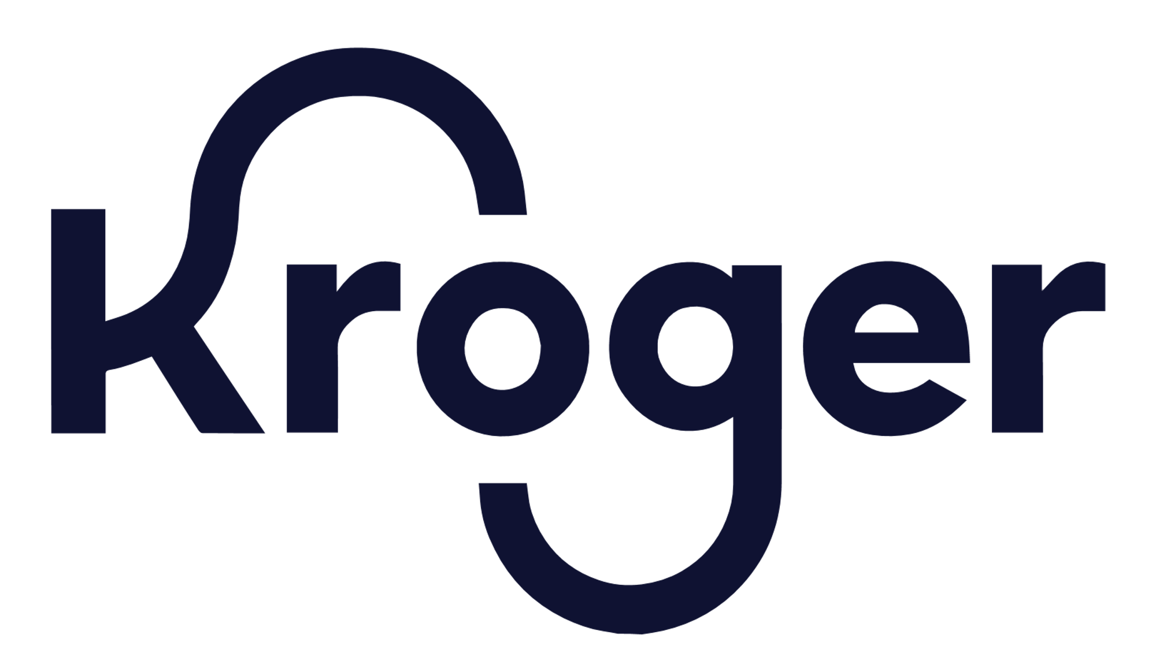


Case Studies: Supplier Segmentation
Client | Kroger
Focus Area | Supply Chain Segmentation
Country | United States
Sector | Retail
Use case | Use the Risk Ratings to segment supply chain based on social and environmental risks.
Client | Super Retail Group
Focus Area | Responsible Sourcing Program Review
Country | Australia
Sector | Retail
Use case | Leveraged the Risk Ratings to review the responsible sourcing program
Client | Customer
Focus Area | Supply Chain Segmentation
Country | United States
Sector | Food and Beverage
Use case | Utilized the Risk Ratings for a risk-based process for commodities and countries. It enabled the client to standardize risk ranking and scoring mechanisms, evaluate specific risks within different supply chains.
Kroger engages consultant ELEVATE to regularly assess Kroger’s supply chain and apply segmentation based on social and environmental risk. Through the process, we classify primary product and commodity categories in our supply chain based on two dimensions:
Risk level (high, medium or low)
Kroger’s ability to influence risk in the supply chain (high, medium or low leverage)
Link here
To better understand our supply chain and enhance
our approach to risk and factory segmentation, including the impact of high -risk products, we continued to invest in ELEVATE’s EiQ supply chain intelligence platform. During FY23 we gained better insight into potential risk at Factories. We will use this knowledge as part of our overall Responsible Sourcing Program review process in FY24 to enhance our program’s effectiveness and our targeted approach to supply chain risk management
Link here
Utilizing ELEVATE’s EiQ tool, ADM began a risk-ranking process for commodities and countries. This comprehensive platform allows us to standardize risk ranking and scoring mechanisms, evaluate specific risks within different supply chains, monitor news and press, and ensure proper focus on salient human rights risks.
Link here
Customer Responsible Sourcing Program

Slide 53
Thank You!
Any Questions?
www.lrqa.com

